Slide 1


Telecom Churn Analysis

Slide 2
Telecom Churn Analysis
Group No. 9
Team Members:
Venkata Sai Pavan Teja Angina
Akhil Anilkumar
Shivaprasad G
Sahil Kumar Meher
Arun SV
Under Esteemed Guidance of
Mrs. Pranita Mahajan

Slide 3

Brief Overview
Churn Prediction is one of the most popular Big Data use cases in Business. It consists of detecting customers who are likely to cancel a subscription a service.
Churn is a problem for telecom industries because it is more expensive to acquire a new customer than to keep your existing from leaving.
NOTE :- Telecom Industry today measure voluntary churn by a monthly figure, such as 1.9 or 2.1 percent.

Slide 4
Project Objective
To predict customer churn.
Highlighting the main variables/factors influencing the customer churn.
Use of various ML Classification algorithms to build prediction models, evaluate the accuracy and performance of these models.
Finding out the best model for the given dataset.

Slide 5
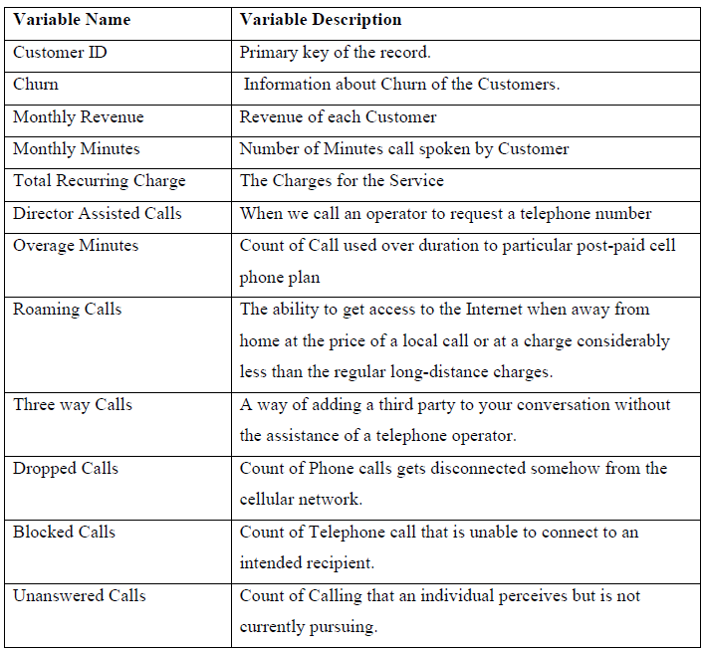
Dataset Information
Data is taken from Kaggle (Telecom churn Dataset)
No. of features: 58
No. of records: 51047
Target Column: Churn
Redundant columns: Customer Id, Service area.
No. categorical columns : 21

Slide 6
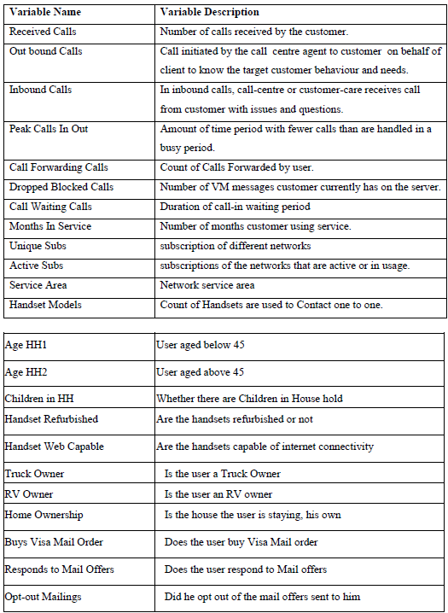
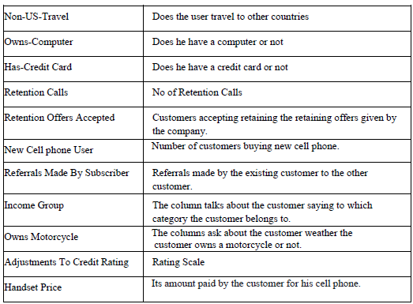

Slide 7
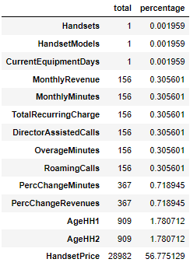
Exploratory Data Analysis (EDA)
Missing Values
Out of 56 features 14 had missing values.
11 of them had less than 1% of missing values, hence the rows were deleted directly.
AgeHH1 and AGEHH2 were treated using median value imputation.
We drop HandsetPrice column since it contains 56% null values

Slide 8
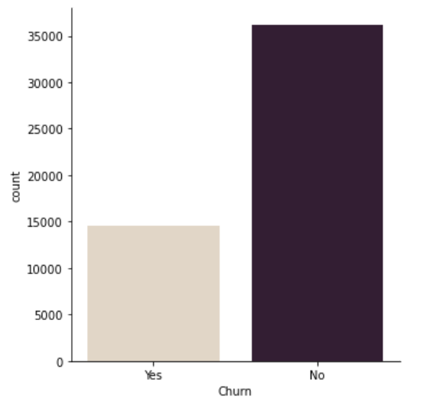
Univariate Analysis
In our data over 28% people have churned ,that is around 14,500 of them.

Slide 9
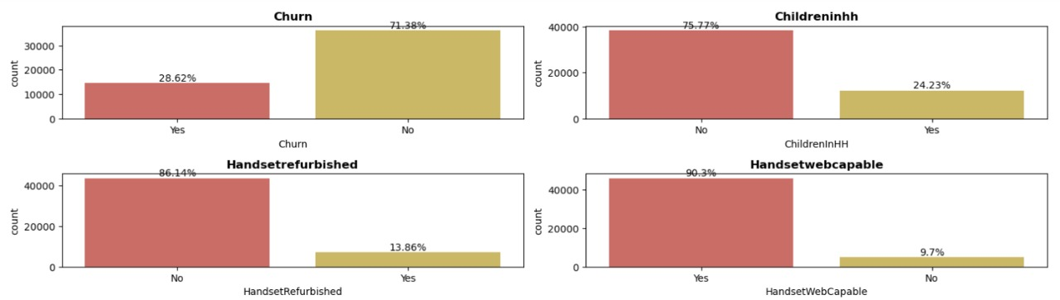
Exploratory Data Analysis (EDA)
Univariate Analysis:
Churn Over 28 percent of people in the data have churned.
2) Handsetwebcapable More than 90 percent of the people in the data have internet support on their phone.

Slide 10
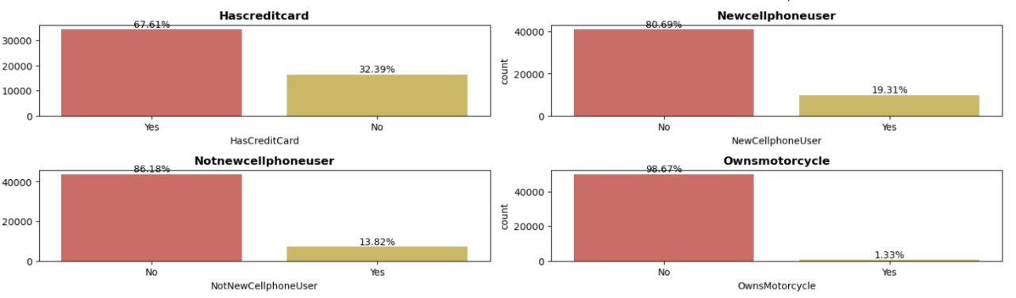
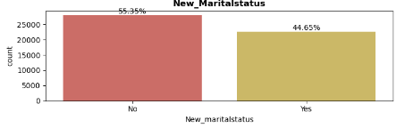
3) More than 65 percent of them don't have a credit card
4) Less than 2 percent of them own a motorcycle
5) More than half of the people's handset price is unknown
6) Over 70 percent of the data has occupations other than the ones mentioned.
7) New Martial status around 45% are married.

Slide 11
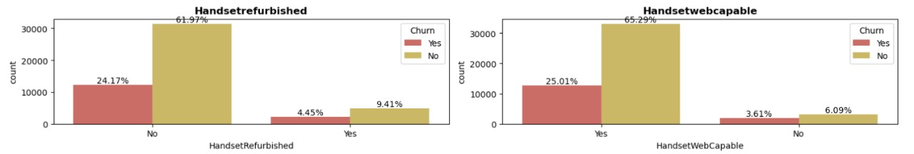
Bivariate and Multivariate Analysis
In Handset web capability over 25% of people who have churned has more than 90% of Internet capability on their phone.
Less than 6% of people who own New phone have churned

Slide 12
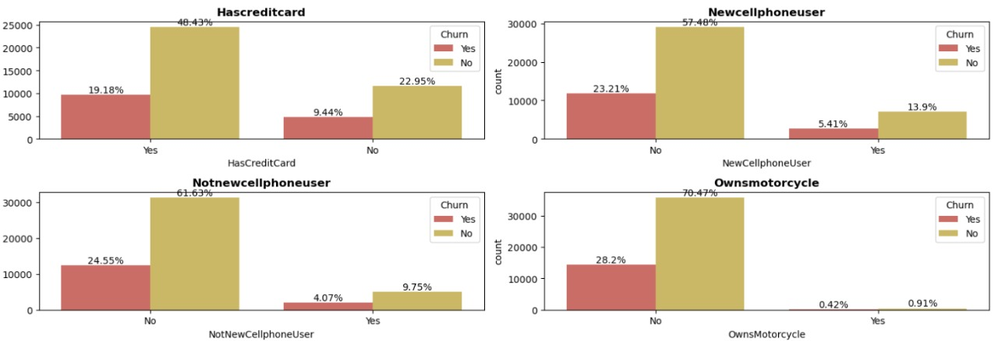
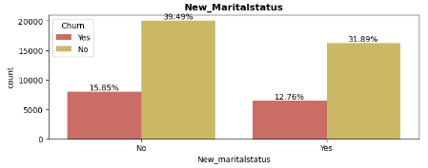
Data show that people who have Credit Cards are more likely to Churn
Marital Status of people churning is independent
People who have responded mail offer are less likely to churn

Slide 13
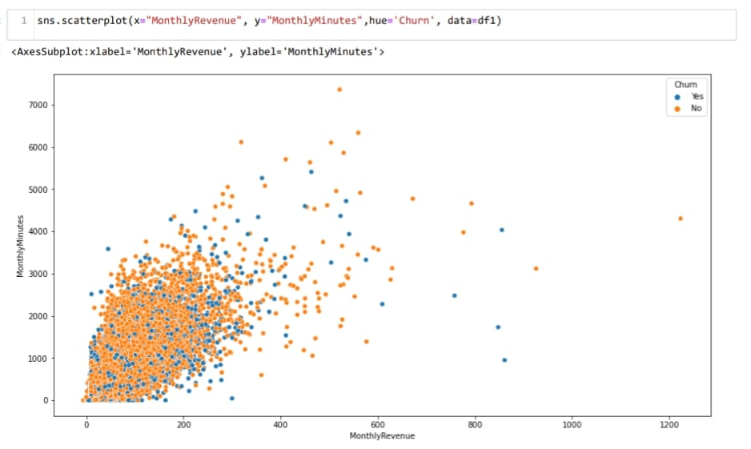
Bivariate and Multivariate Analysis
Observation:
According to plot as Monthly Revenue Increases, Then the number of Monthly Minutes increases, But we can't draw any conclusion on churn

Slide 14
Statistics
Chi-Square Test for Independence :
This test is used to test whether the categorical variables are independent or not.
𝐻0: The variables are independent
𝐻1: The variables are not independent (i.e. variables are dependent)
Here we can check if the categorical features are dependent on our target . We are assuming the level of confidence as 95%
The dependent categorical variable found after Chi-Square Test for Independence are:
ChildrenInHH
HandsetRefurbished
HandsetWebCapable
Homeownership
BuysViaMailOrder
RespondsToMailOffers
MadeCallToRetentionTeam
CreditRating
PrizmCode
MaritalStatus

Slide 15
Statistics
Kruskal Wallis test to check its dependence on the target variable
The null and alternative hypothesis for Kruskal Wallis test is given as:
𝐻0: The data samples are with equal median (independent).
𝐻1: The data samples do not have equal median(i.e. variables are dependent).
Assuming the level of confidence as 95%
The independent numerical variable found after H-test Test:
RoamingCalls
PercChangeRevenues
CallForwarding
CallsHandsetPrice

Slide 16
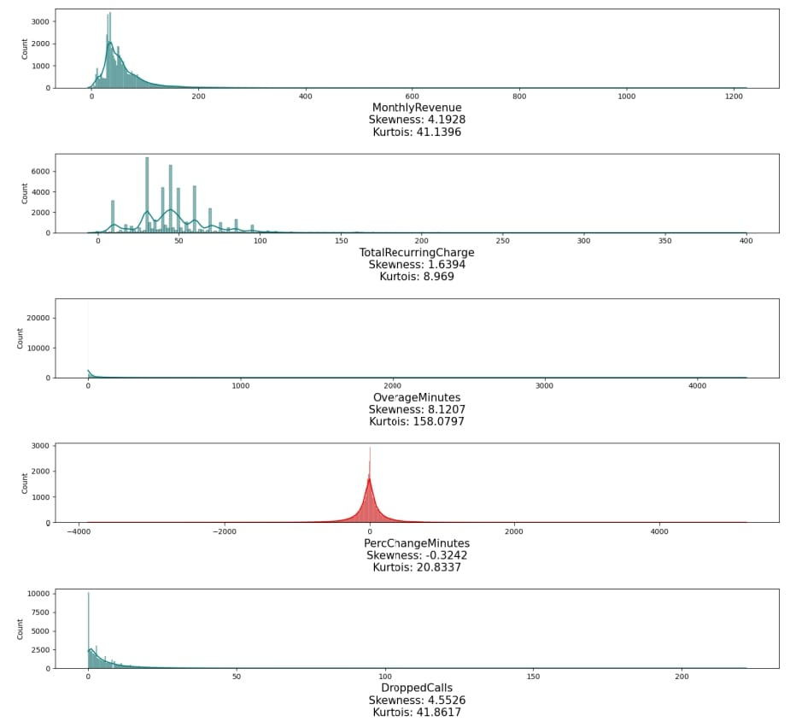
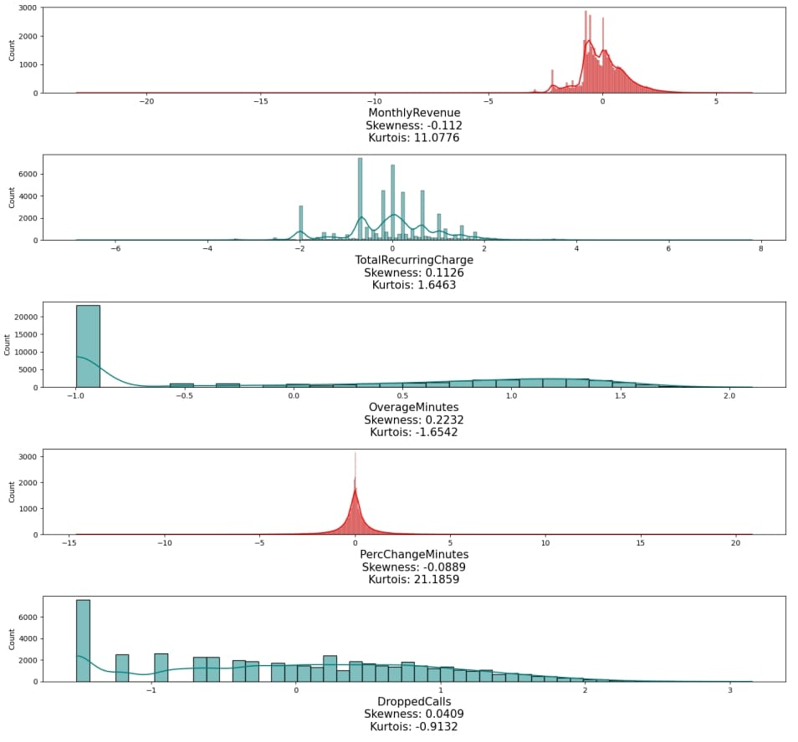
Skewness Before and After Power Transformation

Slide 17
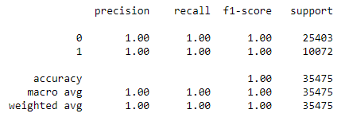
Decision Tree (Base Model)
Classification report for train data:
Observation:
We can see model is 100% accurate on train data.

Slide 18
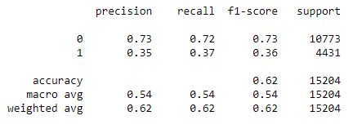
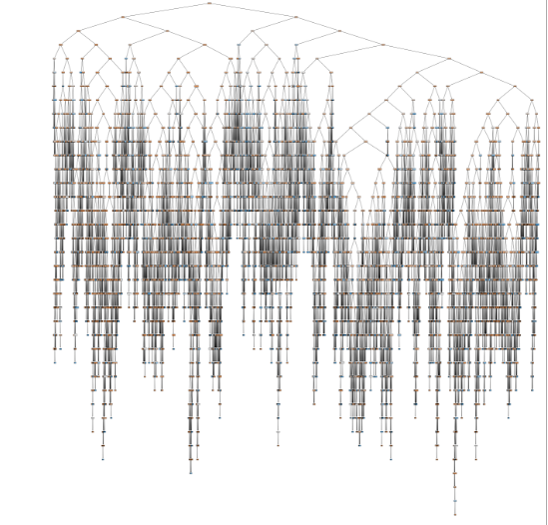
Classification Report for test data:
Decision Tree:
Observation:
We can observe that train accuracy is 100% and test accuracy is 0.62% this means model is overfitted.

Slide 19
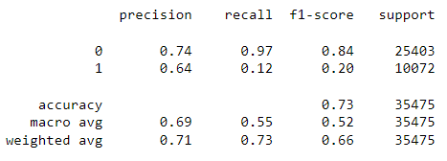
Results After Hyperparameter Tuning :
Observation:
After hyperparameter tuning we got 73% accuracy on train data..

Slide 20
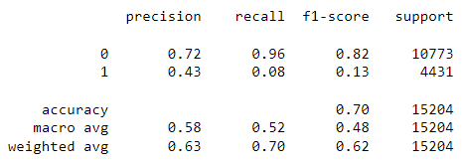
Classification Report for test data:
Observation: After hyperparameter tuning we got 73% accuracy on train data..
Conclusions:
Base model performance is good, but it can be improved using different algorithms
We have to implement various classiﬁcation machine learning algorithms and take feedback for them. This will take us to the best suited model

Slide 21
Thank You

